Slide 1
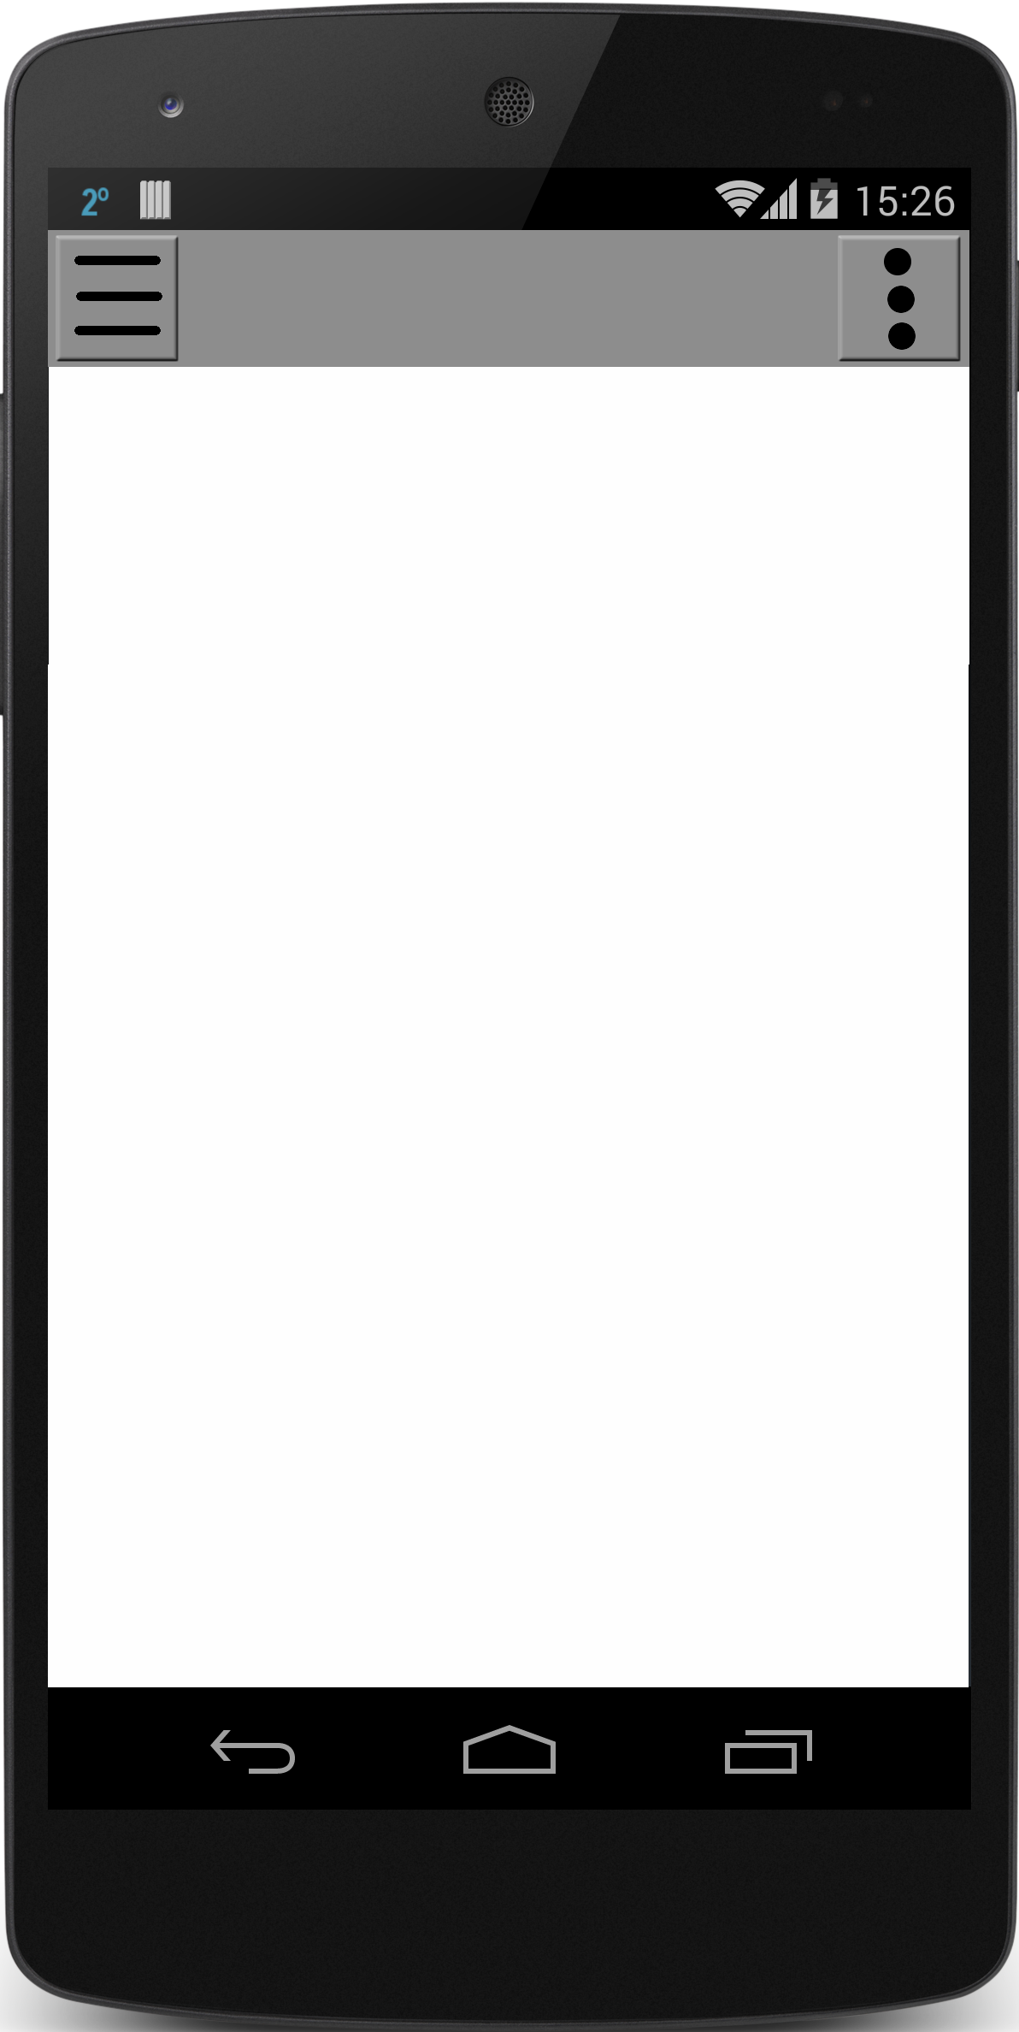
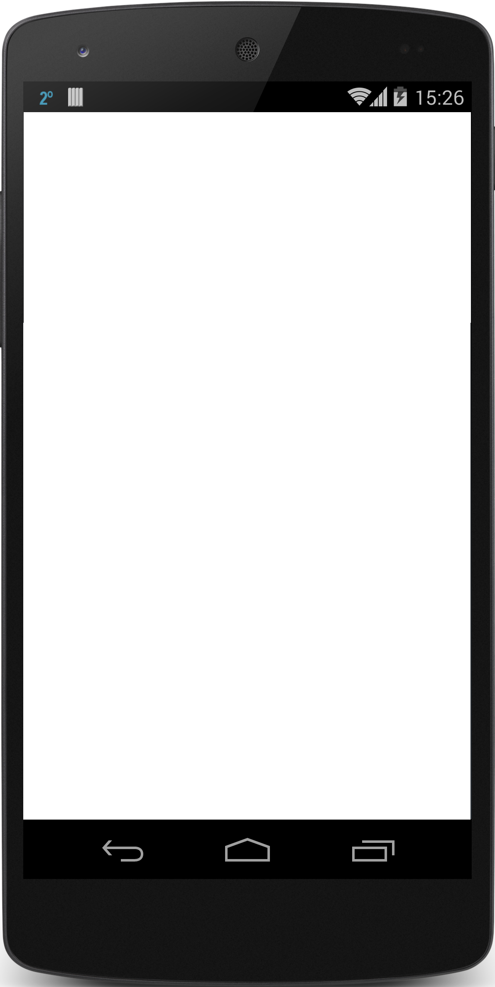

Notes:
TEMPLATES

Slide 2
LOGIN
Username Text
Password Text
Facebook
Register
Forgot Stuff

Slide 3
Login
Who’s Playin’
“Logo Here”
Username
Password
Login
Forgot Password
Register
Facebook
Google
Notes:
Login

Slide 4
Create Account
Create Account
Name
Username
Password
Confirm Password
Email
Phone Number
Create
Cancel

Slide 5
Forgot Password
Reset Password
*Enter Email Phone Number Or Username
Send Email
Notes:
Will parse automatically the texts inputed

Slide 6
Change Password Page
Verification Code
New Password
Confirm Password
Go
Notes:
Get either a text message a email

Slide 7
Home Page
-map
-list
Nav Bar
Settings
Nav Bar
Settings
Map
List
Map
List
Map W/ Pins
Search Bar
Details
# of Results
V
Filter
Title
Place
# of players/ total
Distance
+

Slide 8
Home Page
Game
Title
Nav Bar
Settings
Start/end time
Game Captain
Location
# of players/ total
Description
Pop up (“joined”)
Button changes to
”Leave Game”
Name | # Event | Rating | #Played
JOIN GAME
Message here
>
Notes:
Add list of items to bring button (checklist of game items)

Slide 9
Profile Page
Nav Bar
Settings
Profile
Picture
Name
Age:
Location:
message
Gender:
Rating:
Last Active:
Achievments
<
>
Past games

